Slide 1

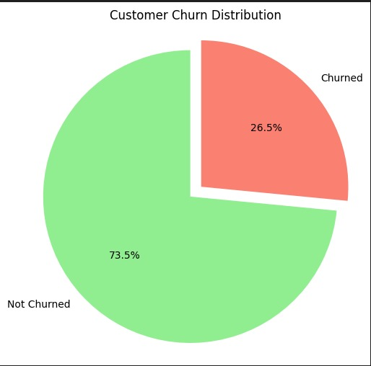
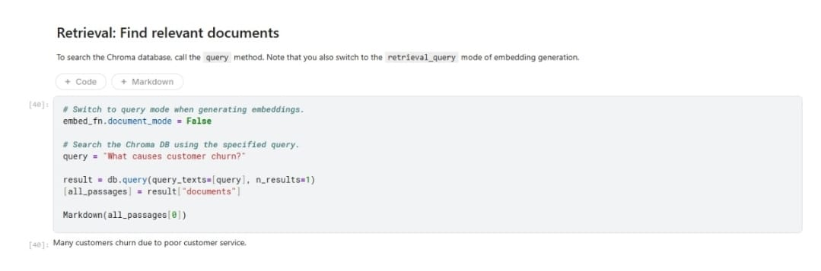
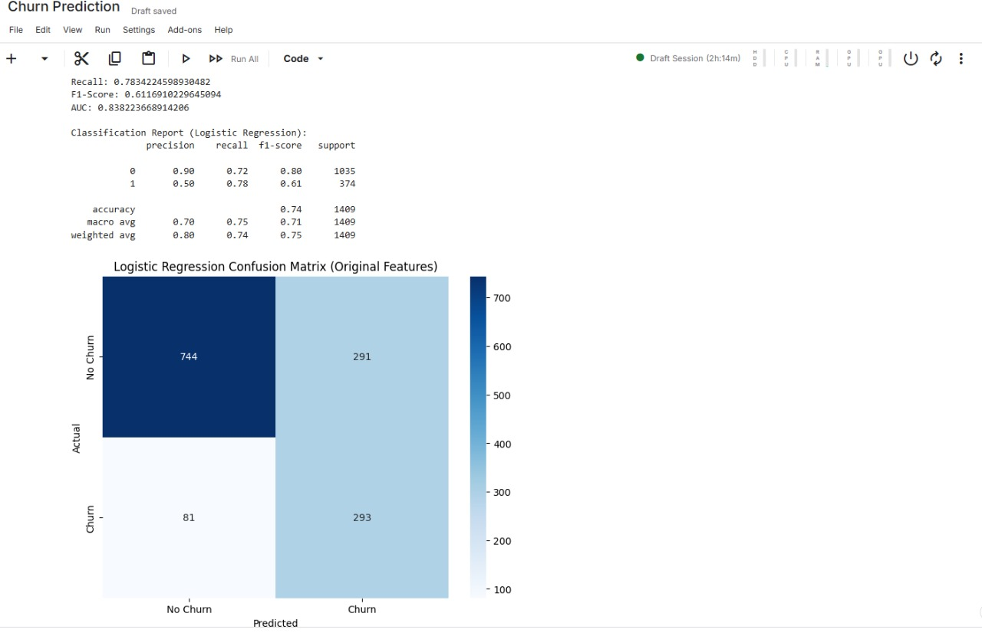
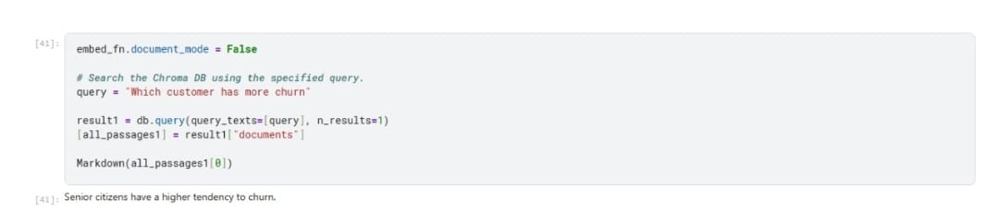
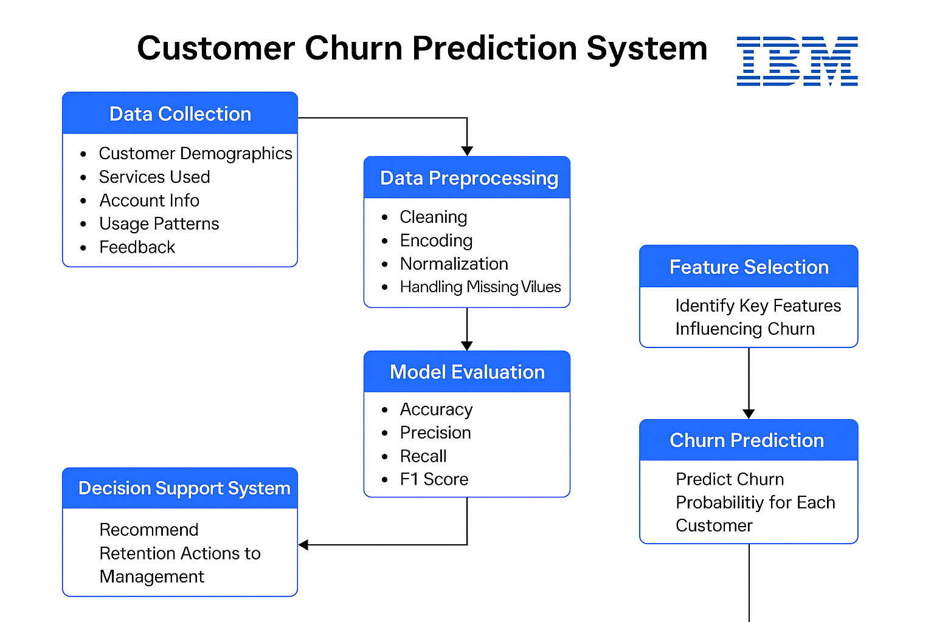
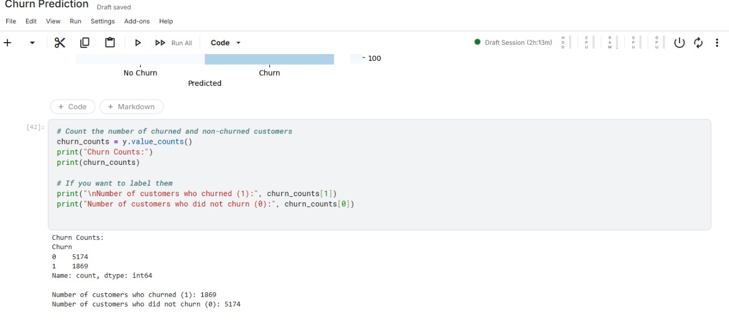
Customer Churn Prediction System For Telecommunication Services
H Mudassar Sharieff (RA2211053010044), Soman Adhithya R K (RA2211053010009),
K Ramachanthran (RA2211053010053)
Under the guidance of: Dr. Nithya V, Associate professor
Department of Electronics and Communication Engineering, SRM Institute of Science and Technology, Kattankulathur
INTRODUCTION
REALISTIC CONSTRAINTS
Churn Distribution: 1,869 churned (label 1), 5,174 non-churned (label 0).
Class Imbalance: Non-churned customers outnumber churned ones, which may bias model performance.
Modeling Implication: Apply resampling, class weighting, or anomaly detection to balance learning between both classes.
In the competitive telecom industry, customer retention is vital. This project, developed for IBM, introduces a Customer Churn Prediction System using machine learning to analyze user behavior and predict churn risk. By leveraging data analytics, the system helps telecom providers take proactive actions, reduce churn rates, and improve customer satisfaction through smarter, data-driven decision-making.
Enterprise Integration: The system must integrate with IBM Cloud, IBM Watson, IBM SPSS, or other IBM infrastructure, which may limit third-party tool usage.
Data Governance & Security: IBM’s strict data handling policies (especially for telecom clients) limit how and where customer data can be stored, processed, or moved (e.g., must be done in-country).
Model Explainability: For enterprise adoption, especially in regulated industries, IBM emphasizes explainable AI (XAI) — the churn model must provide transparent reasoning, not just predictions.
Toolchain Restrictions: Use of IBM-preferred technologies like Watson Studio, Db2, Cognos Analytics, etc., may constrain implementation choices.
MOTIVATION
Fig. 4 Customer Churn Distribution Graph
Customer churn directly impacts revenue and growth in the telecom sector. Identifying at-risk customers early enables companies to take corrective action. This project is motivated by the need to harness machine learning and data analytics to proactively manage churn, reduce losses, and enhance customer loyalty—aligning with IBM’s vision of data-driven business transformation and innovation.
Majority of Customers Retained: 73.5% of the customers have not churned, indicating that the business retains a substantial portion of its customer base.
Significant Churn Rate: 26.5% of customers have churned, which is a notable proportion and signals an area where customer retention strategies can be improved.
Churn Rate Insight: The graph shows that 26.5% of customers have churned, highlighting a meaningful portion of the customer base that the business risks losing, which calls for focused retention efforts.
DESIGN
Fig. 2 Sample Output Reason for Customer Churn.
PROBLEM STATEMENT
Relevant Information Retrieved: The output provides a concise answer — "Many customers churn due to poor customer service." — which directly addresses the query "What causes customer churn?".
Query Result Limitation: Only one result (n_results=1) was requested from the Chroma database, so the output shows the most relevant document or passage matching the query.
Clear and Focused Response: The retrieved document focuses specifically on one clear cause of customer churn (poor customer service), demonstrating effective and precise retrieval from the database.
Telecommunication companies face increasing challenges in retaining customers due to market competition and changing user preferences. Identifying customers likely to churn is difficult using traditional methods. This project addresses the need for an intelligent system that uses machine learning to accurately predict churn, enabling timely interventions and improving customer retention strategies for IBM’s telecom clients.
.
CONCLUSION
Accurate Prediction: The system effectively identifies customers likely to churn using machine learning models.
Proactive Retention: Early detection enables timely retention strategies, reducing customer loss.
Business Impact: Improves decision-making and enhances customer satisfaction for telecom providers.
IBM Integration: Aligns with IBM’s vision of using AI and analytics to solve real-world business problems.
METHODOLOGY
Fig. Confusion Matrix
REFERENCES
RESULTS & INFERENCE
[1] A. K. Ahmad, A. R. Abdullah, A. A. A. Zaidan, and B. B. Zaidan, "Customer churn prediction in telecom using machine learning in big data platform," Journal of Big Data, 2020.
[2] B. Huang, M. T. Kechadi, and B. Buckley, "Customer churn prediction in telecommunications," Expert Systems with Applications, 2012.
[3] P. Lalwani, M. K. Mishra, J. S. Chadha, and P. Sethi, "Customer churn prediction system: a machine learning approach," Telecommunication Systems, 2021.
[4] V. Lazarov and M. Capota, "Churn prediction," Technische Universität München, 2013.
[5] S. K. Poudel, S. Pokharel, and M. Timilsina, "Predictive modeling study of customer churn using structured telecom data," International Journal of Computer Applications, 2021.
Fig. 3 Identifying Customer Segments with Higher Churn Risk.
Targeted Query on Customer Churn: The query "Which customer has more churn?" is designed to identify specific customer segments that are more prone to leaving, providing actionable insights for customer retention strategies.
Clear Retrieval Output: The output directly answers the query by stating — "Senior citizens have a higher tendency to churn." highlighting that age (senior citizens) is a significant factor influencing churn.
Efficient Database Query: Similar to the previous example, the db.query function retrieves only the top 1 most relevant result (n_results=1), showcasing an efficient and focused search using Chroma DB.
Consistent Embedding Mode Configuration: The code explicitly sets embed_fn.document_mode = False, ensuring the embedding generation is in query mode, which is appropriate for retrieval tasks rather than document embedding tasks.
CONFERENCE PUBLICATION
Fig. 1 Customer Churn Class Counts

